Slide 1

Hosted by quantitative Cell & Molecular Biology, Colorado State University
Open Source Software Development with XXXXXXX

Slide 2
Open Source Software Development with GitHub
Outline
Open source software and Github
User Testimonials
How to – user interface (Kristin)
How to – commandline (Reed)

Slide 3
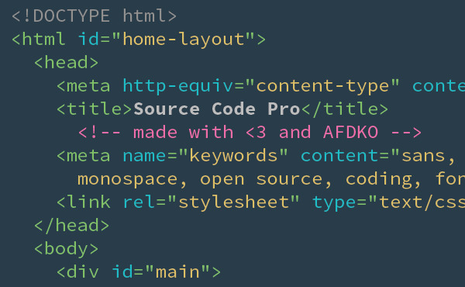

Open Source Software
Source code: the technical blueprint that tells the computer program how to function.

Slide 4








Open Source Software
Open Source: source code that is accessible to inspect, modify, copy and use.
Closed Source: proprietary source code that can not be accessed or change by the public.

Slide 5

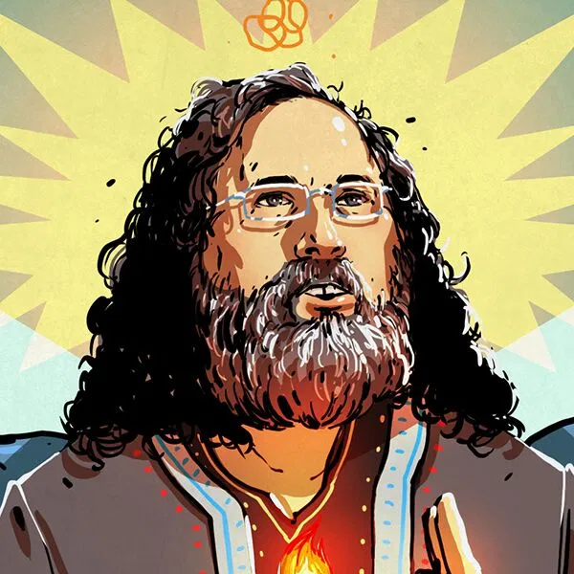
Open Source Software Its a Philosophy!
Proponents believe people should have the right to use their software in whatever way they see fit without licensing restrictions.
Allows software to evolve through open contributions from many users.
Critics worry if open source leads to difficulty in managing programs and wonder if software can be reliably developed without profit intensive.

Slide 6


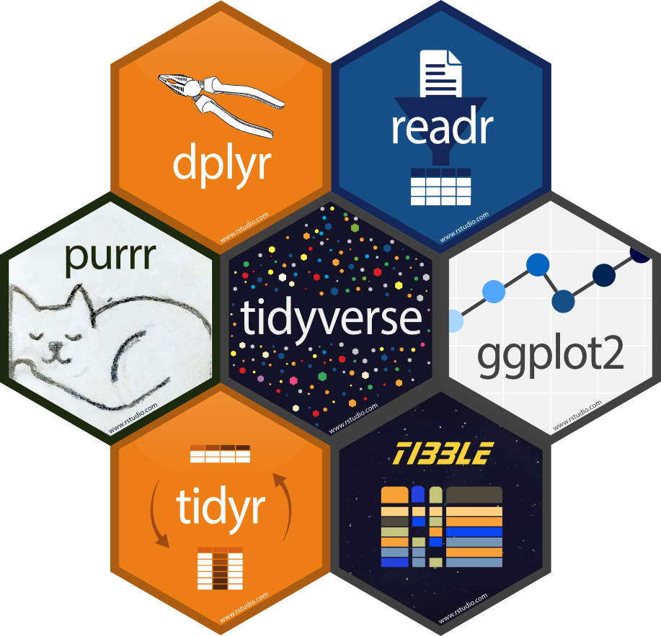



Open Source Software FOR YOU!
Transparency & reproducibility in data analysis
Collaborative development of and easy access to community tools
Coding Portfolio

Slide 7
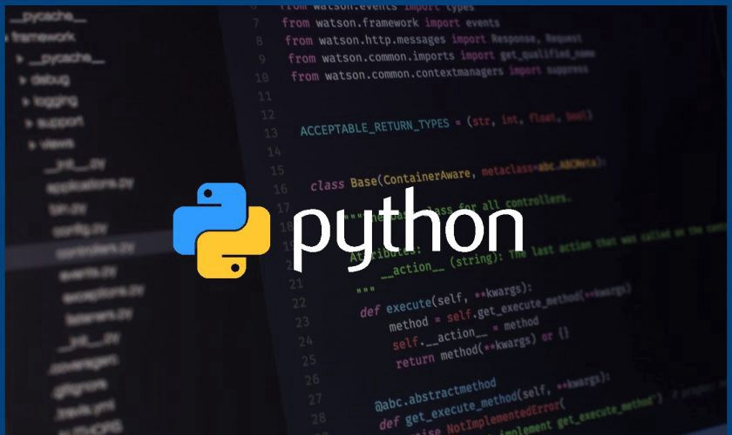

How do you develop open source software?
Write some code
2) Publish on Internet

Slide 8

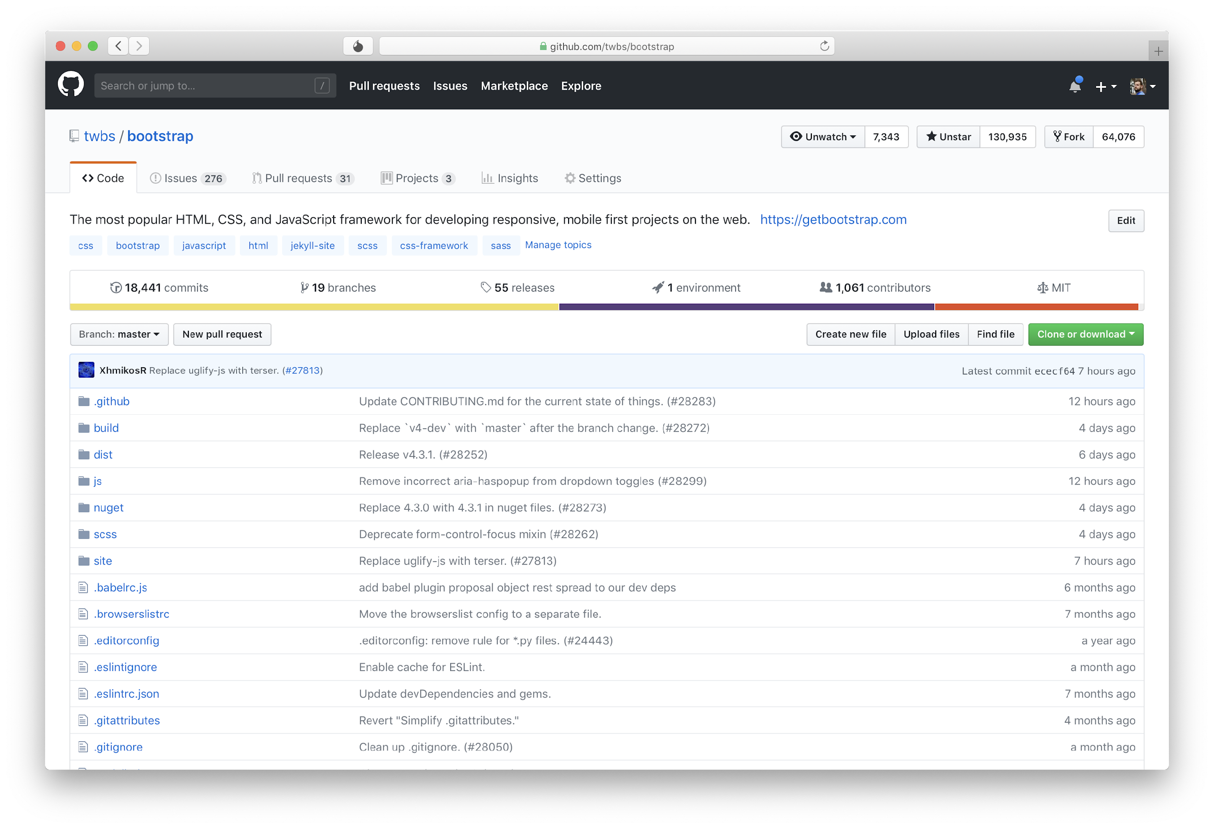
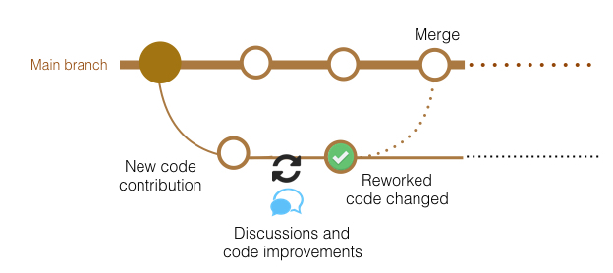
Developing Open Source Software with GitHub

Slide 9
Developing Open Source Software with GitHub
Resources:
GitHub’s User manual
Community support
YouTube
Google!

Slide 10
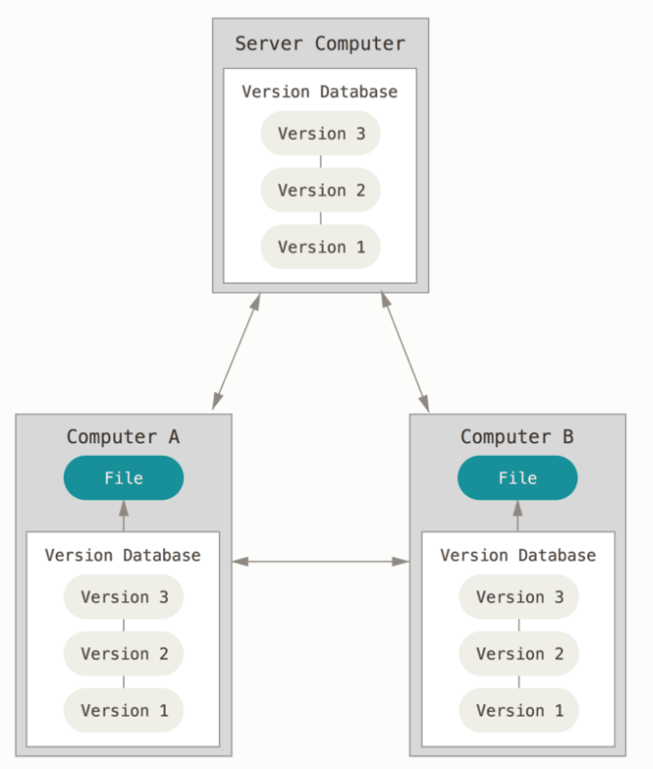
Version Control
Version control is a system that records changes to a file or set of files over time so that you can recall specific versions later.

Slide 11
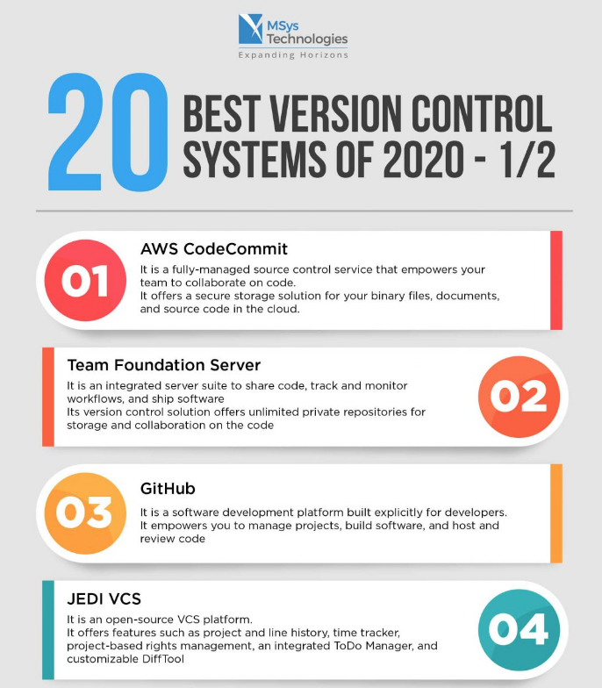
Version Control

Slide 12
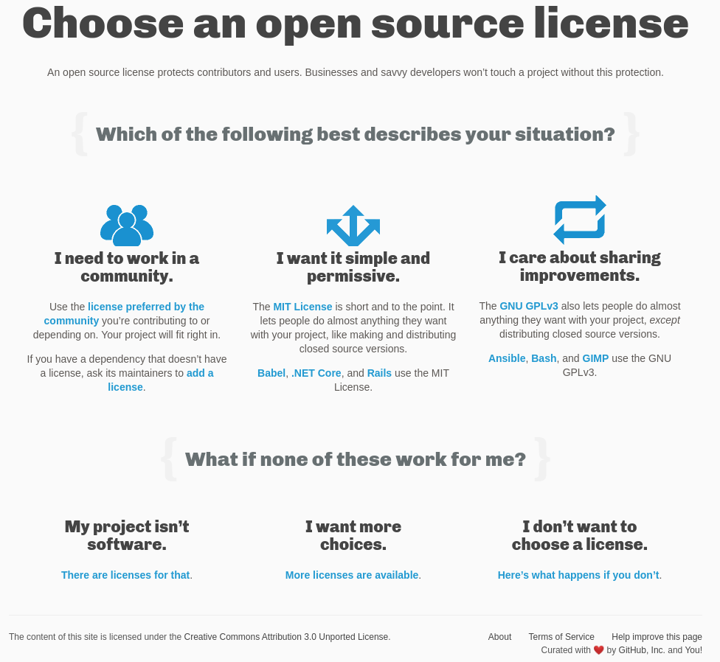
Protecting Your Open Source Projects
choosealicense.com

Slide 13
Protecting Your Open Source Projects
choosealicense.com

Slide 14
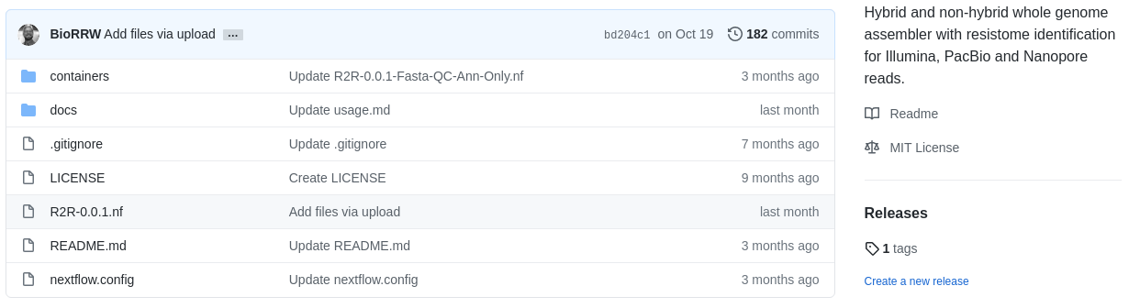
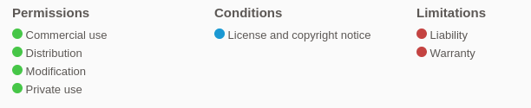
Protecting Your Open Source Projects

Slide 15

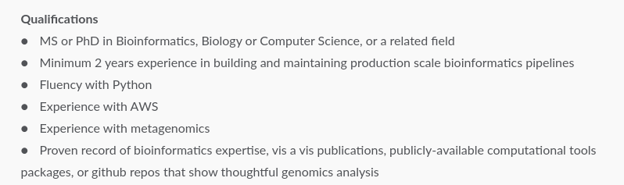
Why would anyone want to use my code?!
How does my open source code help me?
Job posting from Trace Genomics on 11/30/2020

Slide 16



Why would anyone want to use my code?!
How does my open source code help me?
Job posting from Cincinnati Children’s Hospital on 11/30/2020

Slide 17

Who else uses GitHub?

Slide 18
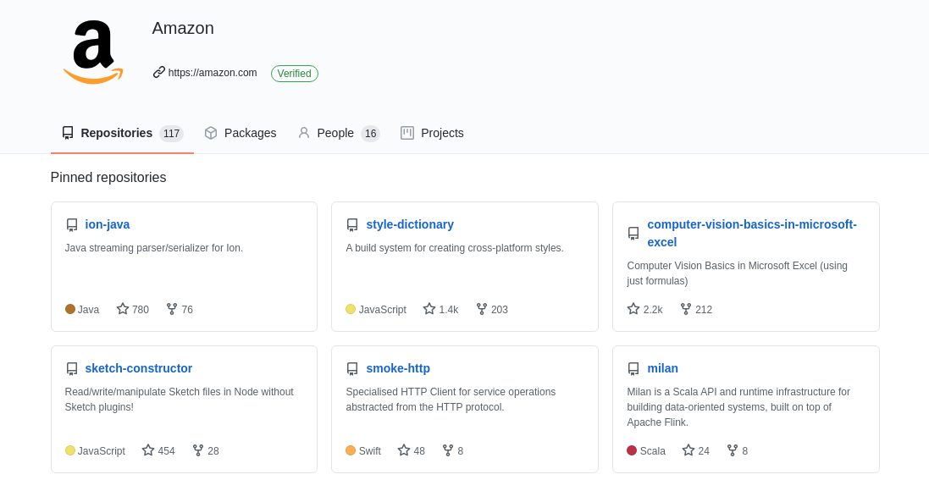
Who else uses GitHub?

Slide 19

How else can I utilize GitHub?
https://github.com/M0nica

Slide 20

How else can I utilize GitHub?
https://lgw2.github.io/

Slide 21
Recap so far
Open Source Software
Allows software to evolve through open contributions from many users
Version Control
a system that records changes to a file or set of files over time
Protecting your work with licences
Ability to centralize and showcase your work and collaborative projects

Slide 22
How is GitHub used in the biological sciences?
Examples from CMB Faculty
Erin Osborne Nishimura
Department of Biochemistry and Molecular Biology

Slide 23
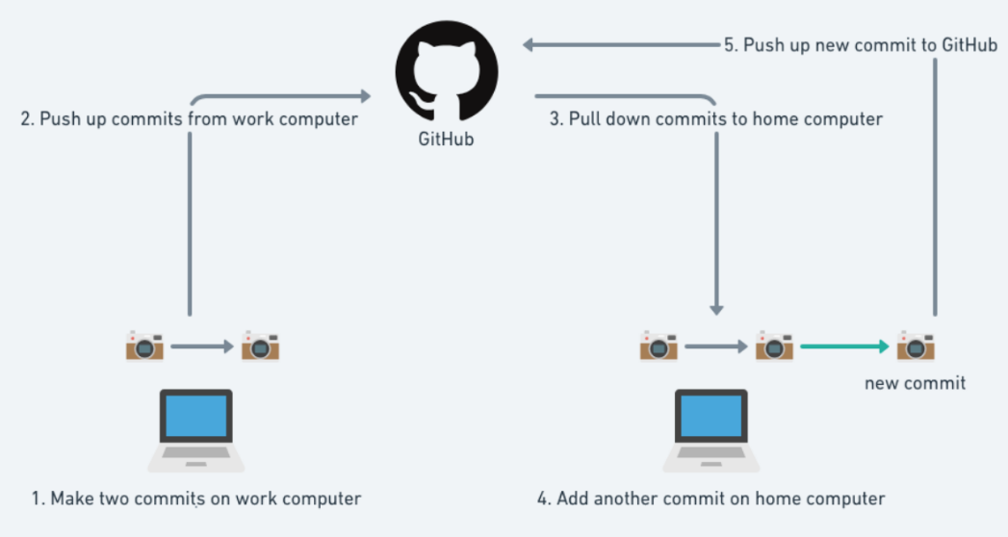
Interacting with GitHub via the command line
https://www.coursereport.com/blog/what-is-github

Slide 24

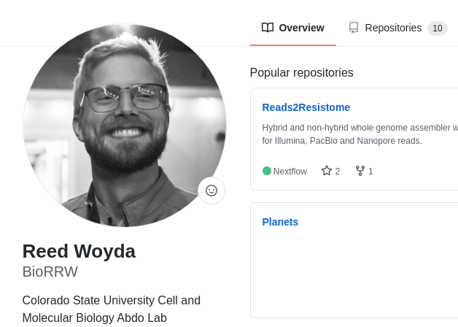
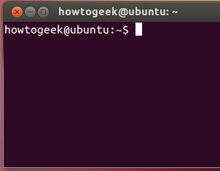
Interacting with GitHub via the command line
What is Git?
Git is the command line version control system (VCS) software which works on your local computer.
Git was created by Linus Torvalds in 2005 for development of Linux
You need Git to use GitHub. You can use Git locally without GitHub.

Slide 25
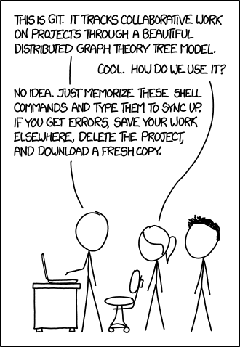
Interacting with GitHub via the command line
Brief introduction on git command line usage:
Cloning existing repositories
Editing code from repositories
Commit modified code to existing repositories

Slide 26
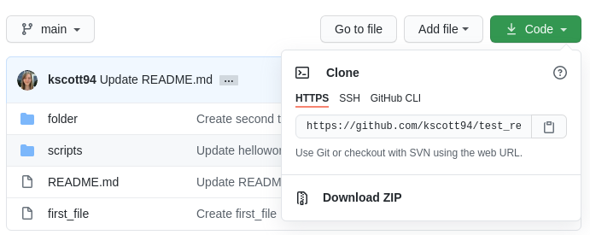
Interacting with GitHub via the command line
How to obtain Open Source code from GitHub
Open terminal on local computer
Navigate to directory of your choosing
git clone https://github.com/kscott94/test_repository.git

Slide 27
Interacting with GitHub via the command line
Collaboration
List of command I used to edit a script from a collaborators GitHub repository:
In desired directory, tell Git who we are:
git config --global user.name "BioRRW"
git config --global user.email reedwoyda@gmail.com
Initialize current directory as a Git repository:
git init
Connect to the desired repository:
git remote add qcmb_github https://github.com/kscott94/test_repository
Make edits to file of choice (here I edited the helloworld.py script)
Prepare the edited file for upload to GitHub:
git add helloworld.py
Lastly, commit the edited file for final upload to the repository:
git commit helloworld.py -m "Updated helloworld.py script"

Slide 28
Recap: How to use GitHub/Git
How to create a GitHub repository
Add content
Add collaborators
How to download a repository from GitHub (command-line)
How to ‘connect’ to an existing repository for collaboration (command-line)
Make edits
Commit those edits to the GitHub repository
See edits reflected in GitHub repository

Slide 29
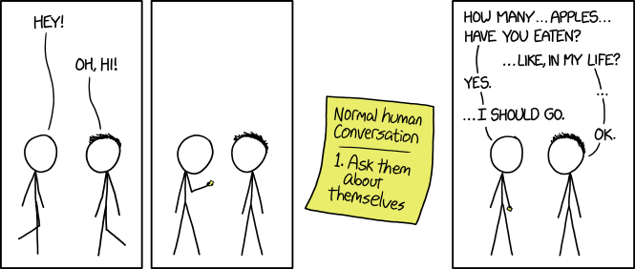
Open Discussion/Questions

Slide 30
Resources
Basic Git usage
https://git-scm.com/docs/gittutorial
Basic GitHub Guide
https://guides.github.com/activities/hello-world/
https://pages.github.com/
GitHub documentation
https://docs.github.com/en
Git/GitHub usage (Youtube)
https://www.youtube.com/watch?v=SWYqp7iY_Tc&ab_channel=TraversyMedia

